Slide 1


Save Big Money
By Investing in Testing
Champion bull, Deets, photo © by and used with permission of of The Double D Ranch, thedoubled@aol.com
Black bear photo © by and used with permission of of Wild Things Photography, tah@wildthingsphoto.com
Rex Black
RBCS, Inc.
31520 Beck Road
Bulverde, TX 78163 USA
Ph: +1 (830) 438-4830
Fax: +1 (830) 438-4831
www.rexblackconsulting.com
rex_black@rexblackconsulting.com

Slide 2
Testing Doesn’t Cost, It Saves
A well-established concept
  In Quality Is Free, Crosby argued that economic benefits of quality always exceed costs
  In Quality Control Handbook, Juran and Gryna explained the cost of quality model
Does this hold for software?
  Slaughter, Harter, and Krishnan in “Evaluating the Cost of Software Quality”
  Campanella, et al., in Principles of Quality Costs, especially the Raytheon Electronic Systems group case study
If testing returns more to the company than it costs, can we quantify these benefits?

Slide 3

Four Ways Testing Saves Money
Smart test groups, employing effective and efficient test techniques, can save money in four ways:
  Finding bugs that get fixed—or even preventing them
  Finding bugs that don’t get fixed—but are known
  Running tests that mitigate (potentially expensive) risks
  Guiding the project to success through timely, accurate, credible information for project tracking
Let’s see how…

Slide 4
Finding Bugs that Get Fixed
The idea that it’s cheaper to find and fix bugs before release is formalized in a concept called cost of (poor) quality
  C_{quality} = C_{conformance} + C_{nonconformance}
  Conformance costs include testing (finding bugs, a.k.a. defects) and quality assurance (preventing bugs)
  Nonconformance costs include fixing bugs, retesting, dealing with angry customers, damage to company image, lost business, etc.
Can investing in testing reduce the cost of quality?
  Let’s look at a hypothetical case study
  Conformance costs: manual, automated, static testing only (no QA)
  Nonconformance costs: fixing bugs only (no intangibles)
  Assume 1,000 must-fix bugs in each (quarterly) release
  Assume following bug-fix costs: $1 in review, $10 in programmer testing, $100 in tester testing, and $1,000 in customer usage

Slide 5
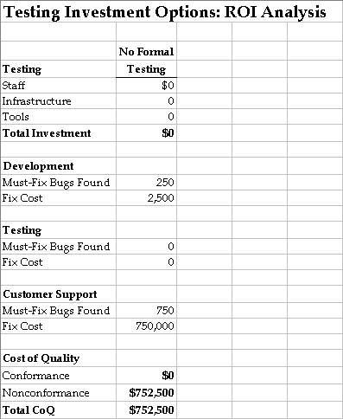
No Formal Testing
1,000 bugs in product
Developers find 250
Customers find 750
Value added by testing:
  None yet—but the opportunity is clear
  Quality costs over 3/4 million dollars…
  …and customers are angry!
Let’s introduce formal manual testing with an
independent test team…

Slide 6
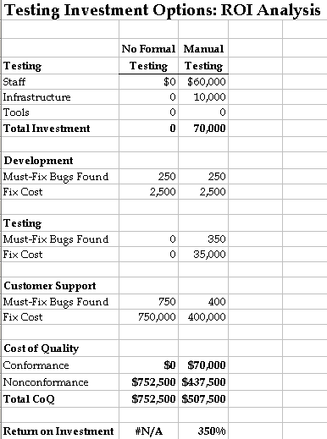
Manual Testing
Invest in testing team
Developers find 250 bugs
Testers find 350 bugs
Value added:
  Quality costs down ~1/3
  Test return on investment (ROI): 350%
  Customers find ~40% fewer bugs
Suppose we can find about
40% more bugs with test automation…

Slide 7
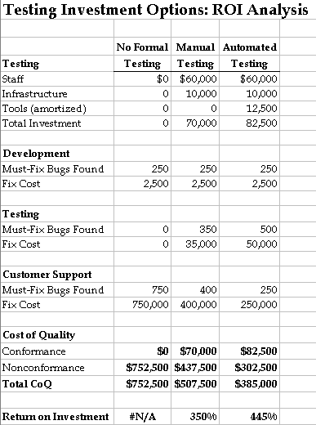
Manual and Automated Testing
Invest $150,000 in tools
  Amortized over twelve quarterly releases
Complement manual
testing with automation
Value added by testing:
  Quality costs halved
  Testing ROI: 445%
  Customers find ~66%
  fewer bugs
Maybe we can prevent bugs,
not just detect them...

Slide 8
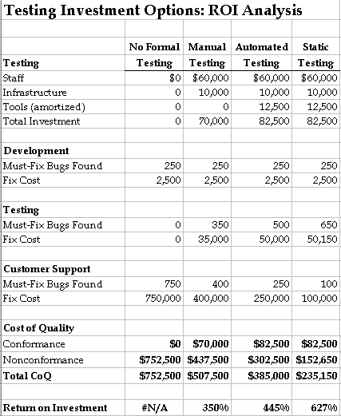
Manual, Automated, and Static Testing
Testers review design
and requirements specs
  Testers ask smart questions
  Prevent 150 bugs
Value added:
  Quality costs
  down by 2/3
  Testing ROI: 627%
  Customers find
  90% fewer bugs
Suppose testers find an additional 650 real—but not must-fix—bugs…

Slide 9
Finding Bugs that Don’t Get Fixed?
So, you’re thinking: What the heck good is that!?!
Well, if we know where the bugs are, we can…
  Prevent the user from seeing the bug
  Warn users in release notes so they can avoid the bug
  Provide workaround and other info to help/support
What are items 1, 2, and 3 worth?
Let’s return to our hypothetical case study…
Important Tips for this Bit of the ROI Equation:
1. Testing should, on average, identify must-fix bugs before non-must-fix bugs.
2. A cross-functional bug triage process should place bugs into each category.

Slide 10
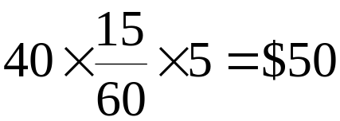
ROI for Bugs that Don’t Get Fixed
Suppose the help desk or technical support staff know that, on average (with significant variation around the mean):
  A call for a known bug is 15 minutes shorter than a call for an unknown bug
  Each bug generates five calls to tech support
  A tech support person costs the organization $40 per hour
Then, each bug found, even if not fixed, saves (based on item 3 alone) :
Challenge: Quantify the benefit of finding the bugs users are preventing from seeing (item 1) or manage to avoid (item 2). Perhaps you can estimate the tech support calls that didn’t happen? How about user time that didn’t get wasted?

Slide 11
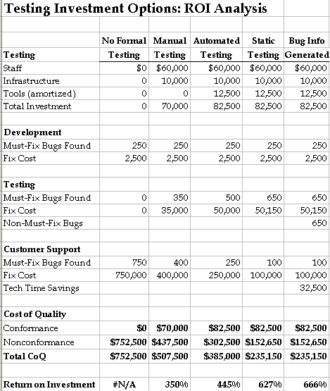
Bug Information ROI Analysis
Testers are finding the non-must-fix bugs already
  No increased investment
Value added:
  $32,500 worth of tech support time saved
  Testing ROI: 666%
  Tech support people are happier…
And testing adds
more value...

Slide 12
Testing is like Insurance
Testing reduces what risk managers call the cost of exposure
  Testing manages risks to quality, which have financial consequences
  We buy insurance to mitigate serious financial risks
Consider the economic concept of substitution
  Insurance: a statistical mechanism for pooling risk
  Conceptually there’s no reason why that pooled risk couldn’t be the risks to the quality of a system being developed
Can we quantify the value of a test risk mitigation?
  Insurance model: Expected payout = probability of loss ∗ cost of loss
  Value of test: The cost of likely field failures in tested behaviors
Going back to the hypothetical case study…
Substitution: use of an alternative product or service that provides similar utility

Slide 13
Insurance as a Substitute for Testing
Suppose we estimate the following factors for quality risks based on similar (technical, organization, business) projects:
  Performance problems: $100,000 average loss, 10% likelihood
  Functionality problems: $5,000 average loss, 50% likelihood
  Security problems: $250,000 average loss, 5% likelihood
  Other problems: $10,000 average loss, 10% likelihood
Then, insurance for these risks would cost at least:
Three Caveats to this Method:
1) Average costs and likelihoods probably based on a small sample of projects.
2) Some organizations are less risk-averse than others, and wouldn’t buy insurance for risks to system quality even at a fair—or bargain—price.
3) The testers won’t pay the project team for external failure (i.e., missed bugs).

Slide 14
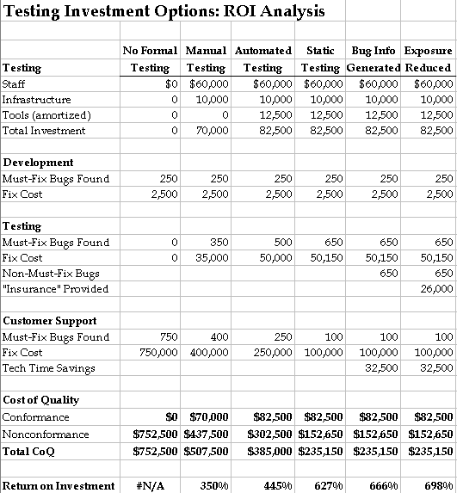
Insurance ROI Analysis
Testers are testing these areas already
  No increased investment
Value added:
  $26,000 worth of “insurance”
  Testing ROI: 698%
  Management
  is more comfortable…
And testing creates information…

Slide 15
Testing Information Guides Project Success
In Estimating Software Costs, Capers Jones identifies poor project tracking as a key cause of project failure
  Accurate, credible, timely testing metrics (defects, tests completed, etc.) are a key part of the project information needed for tracking
  We can extrapolate Jones’ figures for a medium-sized project: good project tracking reduces the risk of project failure from 40% to 20%
  If good testing and test metrics can provide half of this risk reduction benefit, then we can claim 10% of the value to the project
For a final look at the ROI in our hypothetical case study…
Caveat: You’ll need to adjust these numbers based on the size of the project you’re working on, because the figures vary significantly. Jones quotes a 2% risk of project failure for very small projects all the way up to an 85% risk of project failure for extremely large projects!

Slide 16
ROI for Test-Related Tracking Information
Assume our hypothetical case study is a medium-sized project
  The information generated by testing will contribute 10% to reducing the risk of project failure
  The project cost is the only value at risk (i.e., we ignore the opportunity costs of project failure)
  The project costs are the testing and development budgets ($82,500 and $247,500, respectively)
So, the value of the tracking information is:

Slide 17
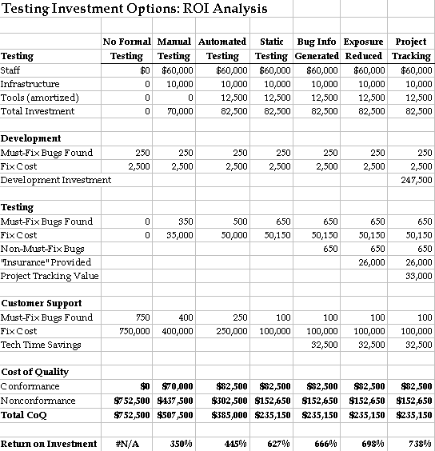
Bug Information ROI Analysis
Test results must be a credible, accurate, timely source of project information
Value added:
  A ten percent reduction in project failure risk (worth $33,000)
  Testing ROI: 738%
  Management is informed…
A respectable business case…

Slide 18
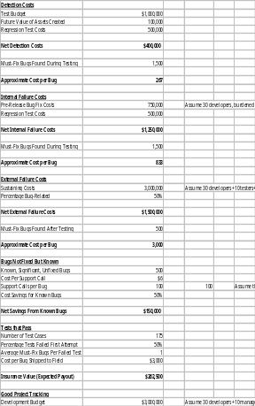
Case Study Testing ROI
Click on the thumbnail to walk through a case study of testing ROI from an Internet appliance test project

Slide 19
Costs of Failure at Your Company
Detection Costs
Test Budget _________
Future Value of Assets Created _________
Regression Test Costs _________
Net Detection Costs _________
Must-Fix Bugs Found During Testing _________
Approximate Cost per Bug _________
Internal Failure Costs
Pre-Release Bug Fix Costs _________
Regression Test Costs _________
Net Internal Failure Costs _________
Must-Fix Bugs Found During Testing _________
Approximate Cost per Bug _________
External Failure Costs
Sustaining Costs _________
Percentage Bug-Related _________
Net External Failure Costs _________
Must-Fix Bugs Found After Testing _________
Approximate Cost per Bug _________

